Slide 1


Crime and Punishment:
2018 Records of Reported Crime and Subsequent Arrests in Chicago, IL
By: Emily S. Watson

Slide 2
Exploratory Analysis
What?
What kinds of crime have been reported? Were some crimes reported at a higher rate than others?
Where?
Where did the most crime occur geographically in the city?
Notable Crimes
What times of the day yielded the more notable crimes? What places did these crimes occur?
What proportion of arrests?
Of the crimes reported, how many yielded arrests subsequent to commission? Which crimes and which areas yielded the most arrests?

Slide 3
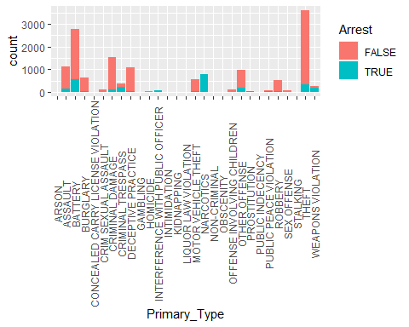
What?
-Total amount of records in data provided = 15,000.
-Theft was the most reported crime; over 3,500 reports of theft.
-Over 20 % of total records was reported theft.
-Battery was a close second; over 2,500 reports of battery.
-Less than 500 arrests made for theft, approximately 500 made for battery.
-Narcotics had an 100% arrest rate.
**Please note that officers had a higher rate of arrest with crimes that they discover the evidence on the person, like battery or narcotics. The evidence is on the victim or the perpetrator.
The coral above represents totals; the blue represents the arrests made on those reported crimes.

Slide 4
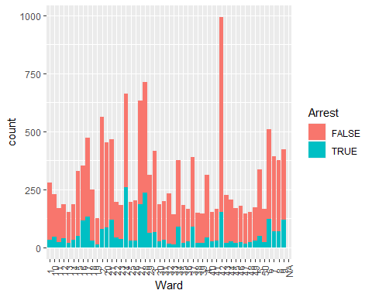
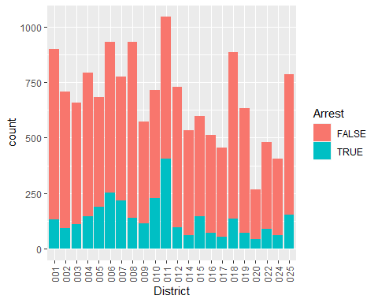
Where?
-Of the 15,000, only 2,450 were reported as domestic incidents, about 16%. Most crimes were reported as having occurred outside of the home.
-The areas of the city that had the most crime were District 11- around Garfield Park and Ward 42.
The coral above represents totals; the blue represents the arrests made on those reported crimes. Please note the high spike above in Ward 42.

Slide 5
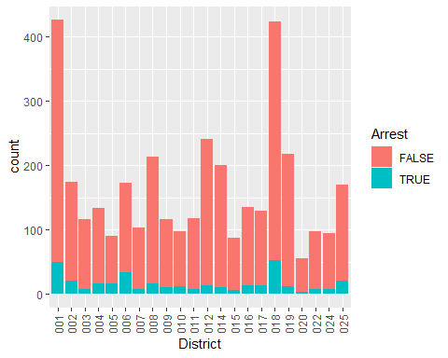
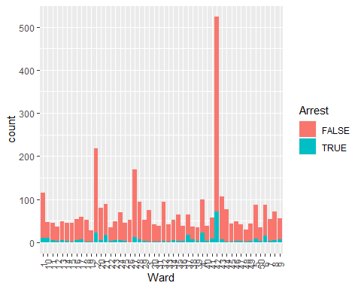
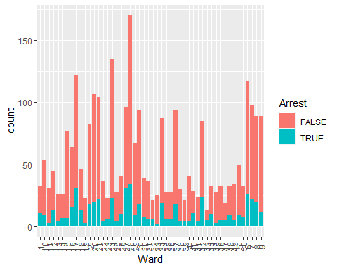
Notable Crimes: Where and When?
The coral below represents totals; the blue represents the arrests made on those reported crimes
-See above for the wards that reported battery in the highest amounts. (24 & 28)
-Most battery is reported between 8 PM and 12 AM.
-Theft was astronomical in Ward 42-also in Districts 1 & 18.
-High reports of theft occurred between 12 PM and 7 PM

Slide 6
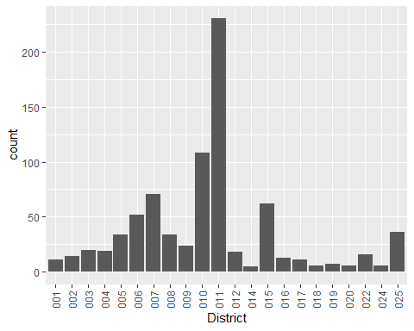
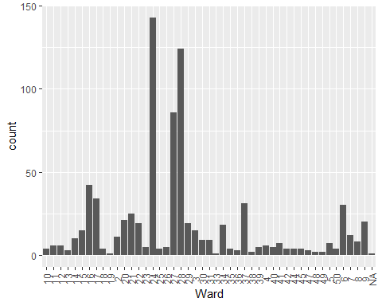
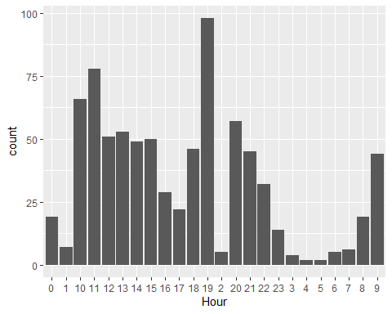
Notable Crimes: Where and When?
-Highest amount of arrests made around 7 PM.
-11 AM also notable.
-Highest levels of narcotic related crime occurred in District 11.
-District 10 also notable.
-Highest levels of narcotic related crime occurred in Wards 24 & 28.
-Ward 27 also notable.
Please note that there are no colors as ALL of these resulted in arrest.

Slide 7
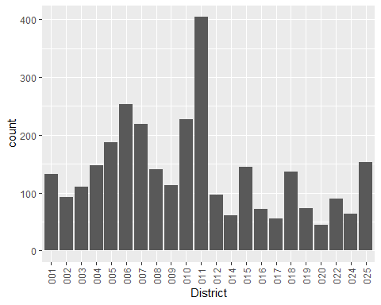
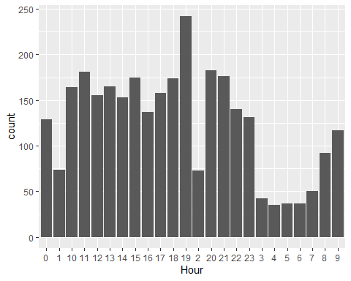
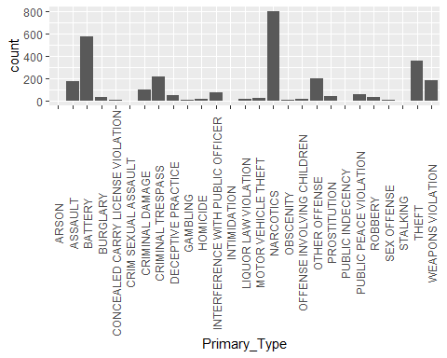
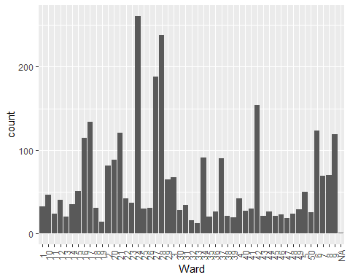
Arrests: Rate & Success
-Narcotics is the most successfully arrested crime of the types in the records provided.
-Most arrests were made around 7 PM.
-District 11 and Wards 24 & 28 yielded the most arrests.
-Of the 15,000 records provided only 3,020 resulted in arrest- 20.1% of the crimes reported resulted in an arrest.
-There was much fewer arrests made in Ward 42 than the wards with the highest arrest counts.
-Theft was the largest unsolved crime amongst these records.

